Slide 1
Efficient-Parking system
To create ease for public and private floors in a different building.

Slide 2
PARTICIPANTS
Hafiz Umair Ahmad Bscs19064
Muhammad Ahmad Ajmal Bscs19022 Mateen Ahmad Bscs19007 Sufian Saeed Bscs19013 Muhammad Abdullah Nezami Bscs19028

Slide 3
Where it can be implemented
In Malls University
Government Building
Private Building
Hospital
The perk of this system is this that it uses special technique to privatized resident.

Slide 4
Why this system
It uses special mechanism to stop public audience to interrupt in private space.
It has a special facility for public to park their cars without hindrance as our system will enable them to select a certain place in a certain floor.
This will allow private space holder participants to easily and securely park their cars.

Slide 5
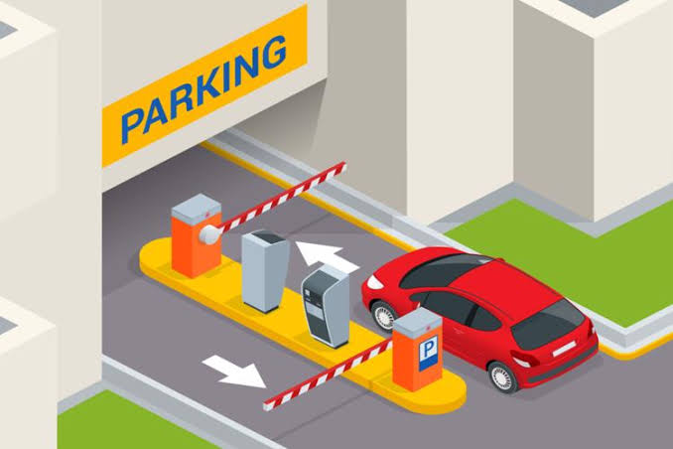
Advantage
It is cheap yet reliable
Private space will be secure Efficient in management

Slide 6
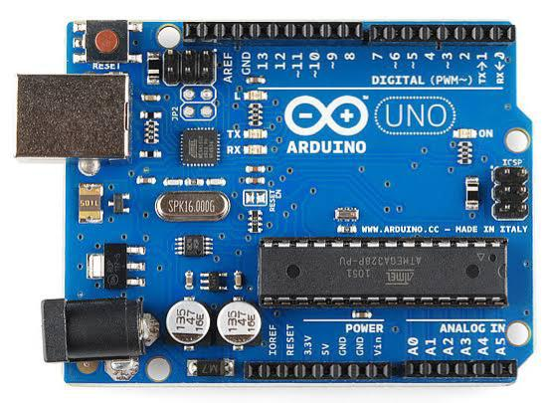
Implementation
We used Arduino and LCDs to setup security gate.
We used multiple Decoders, Encoders,
Full-Adders, 7-segment display, Parallel
Registers, LEDs, D Flip-Flops and logic
States etc.

Slide 7
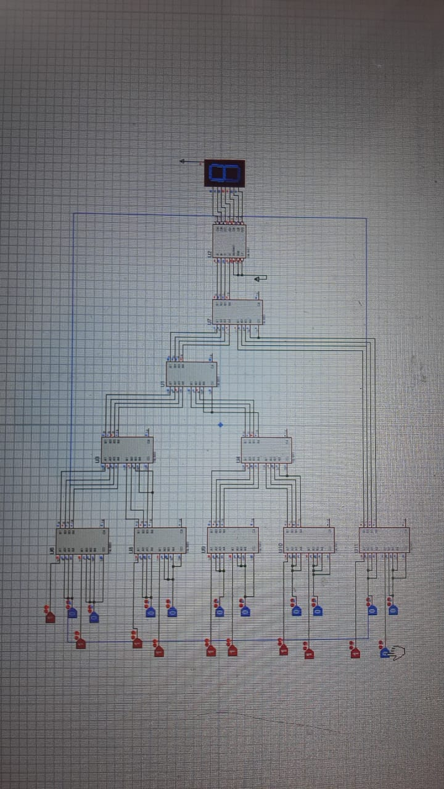
Our circuit snaps
Here are some snaps of our circuit time by time.

Slide 8
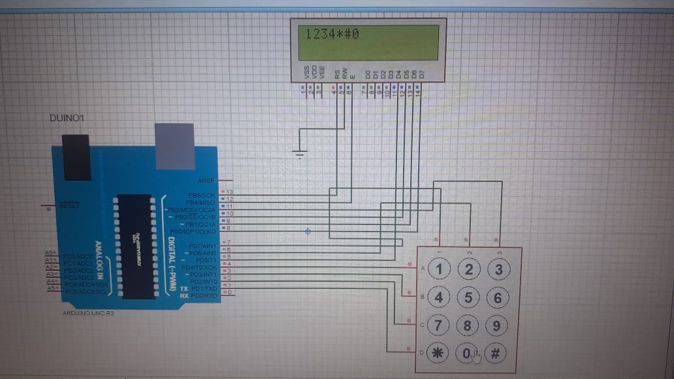
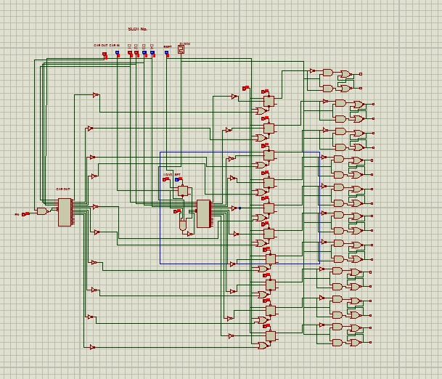
Snaps of circuits

Slide 9
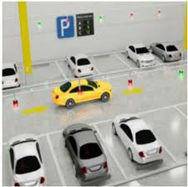
Advantages and set-backs
Advantage:
Our system is expandable to any extent just by replicating the logics and circuits implemented.
Set-Backs:
Simulation of system is limited as we have worked on single sheet in Proteus, did not use child sheets etc.

Slide 10

What we learn
We learn team management
Use of Arduino coding
Decoder's executions
Improve concepts Flip-Flops and registers
applications.

Slide 11
Thank You:)

